Slide 1
Housing Price Prediction
Guided by
Prof. Sumona Mondal
Data Mining (IA650)
Presented by
Sri Deepthi Vootla
Jayakishan Minnekanti
1
7/12/2023

Slide 2
Agenda
Introduction
Dataset
Pipeline
Project Methodology
Summary

Slide 3

Introduction
Estimating factors influencing housing prices.
Helps real estate, aiding both buyers and sellers in making informed decisions.
Using data mining techniques, we can analyze historical housing data to identify patterns, relationships, and important features that influence housing prices.

Slide 4
Dataset
Dataset comes from Kaggle.
https://www.kaggle.com/datasets/yasserh/housing-prices-dataset
There are 546 number of observations and 13 columns.
price | area | bedrooms | bathrooms | stories | mainroad | guestroom | basement | Hotwater heating | Air conditioning | parking | prefarea | Furnishing status
13300000 | 7420 | 4 | 2 | 3 | yes | no | no | no | yes | 2 | yes | furnished
12250000 | 8960 | 4 | 4 | 4 | yes | no | no | no | yes | 3 | no | furnished
12250000 | 9960 | 3 | 2 | 2 | yes | no | yes | no | no | 2 | yes | semi-furnished
12215000 | 7500 | 4 | 2 | 2 | yes | no | yes | no | yes | 3 | yes | furnished
11410000 | 7420 | 4 | 1 | 2 | yes | yes | yes | no | yes | 2 | no | furnished

Slide 5
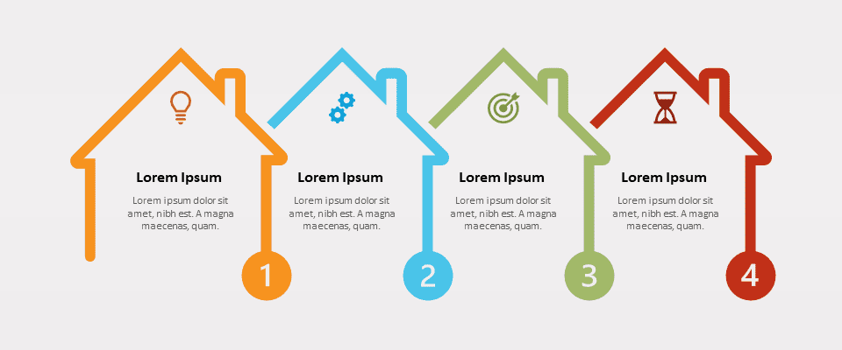
Pipeline
Data Preprocessing
Feature Engineering
Model Optimization
Model Prediction

Slide 6
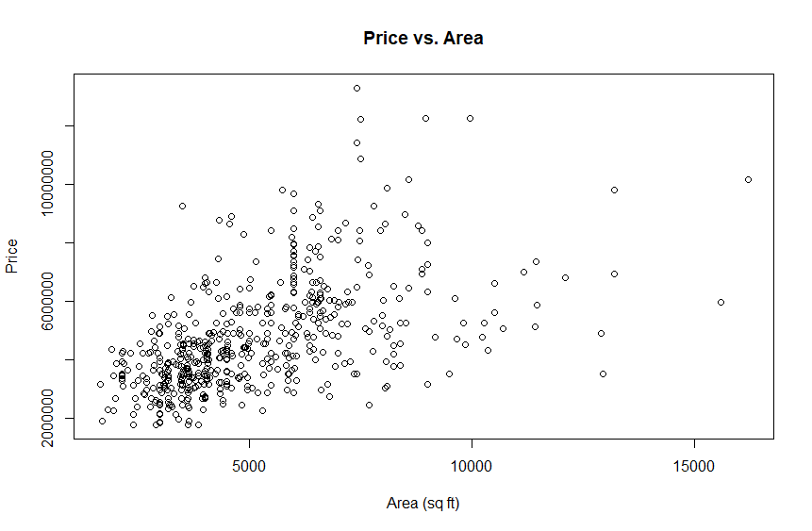
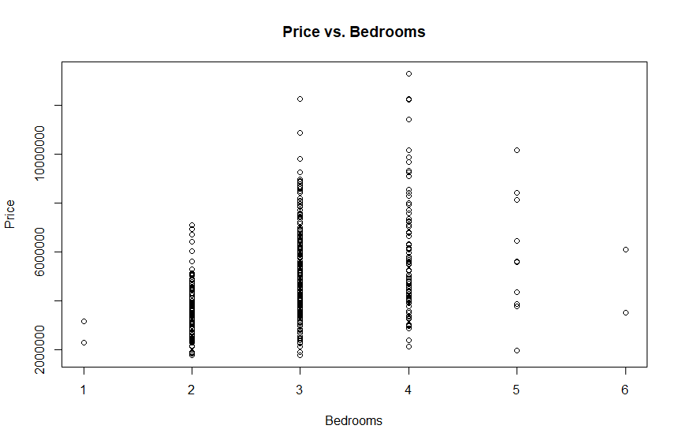
Exploratory Analysis of Data
Explore the dataset to gain insights.
Distribution of variables.
Understand the relationships between features and the target variable.

Slide 7

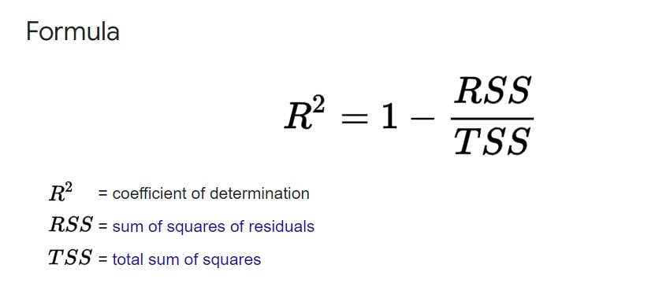
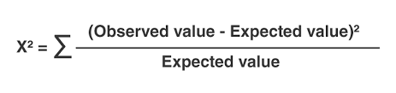
Model selection, training & evaluation
Multiple Linear Regression
ANOVA, Chi-squared, R-squared tests
7/12/2023

Slide 8
Conclusion
In this housing price prediction data mining project, our aim is to develop a reliable predictive model that can accurately estimate the impact of independent factors influencing housing prices. By leveraging data mining techniques and addressing challenges like multicollinearity, we hope to provide valuable insights to buyers, sellers, and real estate professionals.
7/12/2023

Slide 9
Thank you

